Slide 1
Streamgraphs using Protovis.js
Presented By
Subba Reddy Pothireddy
44-599-02 Introduction to Data Visualization

Slide 2
Outline
What is a Streamgraph?
What is Protovis.js?
Goals
Demo
Limitations
Lessons Learned

Slide 3
What is a Streamgraph?
Streamgraph, is a type of stacked area graph which is displaced around a central axis, resulting in a flowing, organic shape.
Streamgraphs were popularized by Lee Byron and their use in a February 2008 New York Times article on movie box office revenues.
For continuous data such as time series, a streamgraph can be used in place of stacked bars.

Slide 4
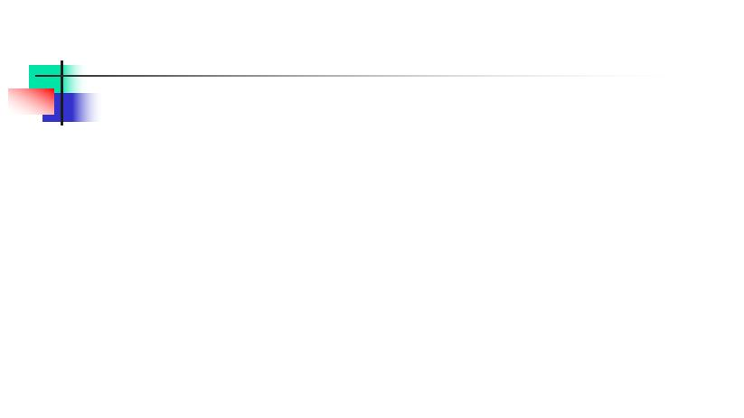
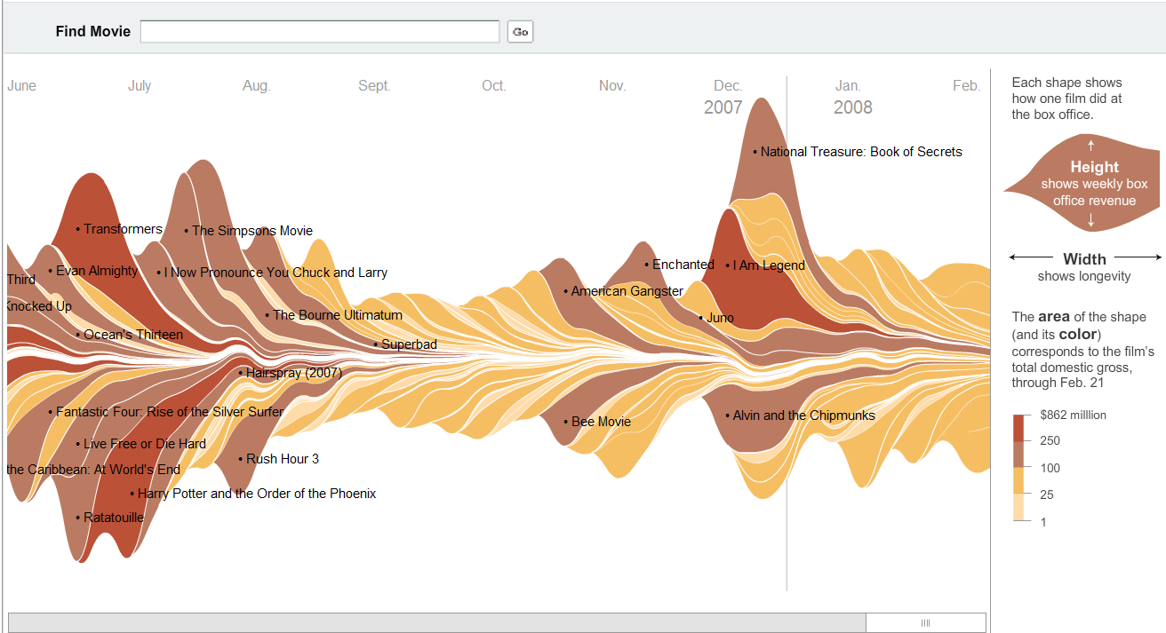
Sample Stream Graph
http://www.nytimes.com/interactive/2008/02/23/movies/20080223_REVENUE_GRAPHIC.html

Slide 5
What is Protovis.js?
Protovis is a JavaScript library for visualizing digital data in the form of graphs and diagrams
The appearance of the graph is encoded by a script with syntax resembling prototype and jquery.
Protovis is a free and open-source, provided under the BSD License.

Slide 6
Goals
Goal 1: To visualize stacked time series of reported occupations in the United States Labor Force from 1850-2000.
Goal 2: To visualize the graph with random data.

Slide 7
Goal1: Sample data
var years = [1850,1860,1870,1880,1900,1910,1920,1930,1940,1950,1960,1970,1980,1990,2000];
var jobs = {
"Accountant / Auditor": {
men: [708,1805,1310,2295,11753,0,111209,181482,0,330352,425002,575667,661606,814842,866460],
women: [0,0,0,0,807,0,15746,14657,0,56117,112853,248441,452783,949683,1217596]
"Actor": {
men: [506,401,1507,3983,10449,15867,14020,28815,12428,10678,10461,11726,0,0,29975],
women: [0,100,200,1994,6736,14106,11001,19210,8750,7067,8069,11127,0,0,25931]
},
….
Total number of records for this dataset are 429
Notes:
http://mbostock.github.io/protovis/ex/jobs.js

Slide 8
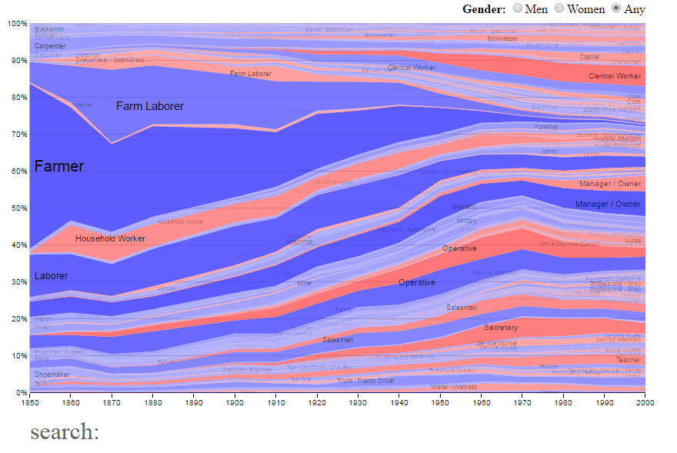
Streamgraph for Goal1

Slide 9
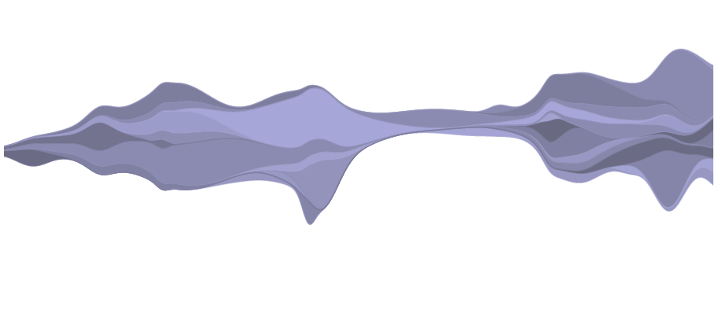
Streamgraph for Goal1

Slide 10
Protovis.js Vs D3.js
Protovis provides a simplified abstraction layer between the visual properties you're specifying, D3 uses the actual CSS and DOM specs
D3 provides utilities for asynchronous requests. When I want this in Protovis, I generally have to use an external library

Slide 11


Slide 12
Lessons Learned
To find out the appropriate data for visualization
Understanding various visualization that can be done using Protovis.js
To use Protovis.js
To document the worksheet
Preparing slides for presentation

Slide 13
Limitations
Only few charts are available
Not much room for customizing

Slide 14
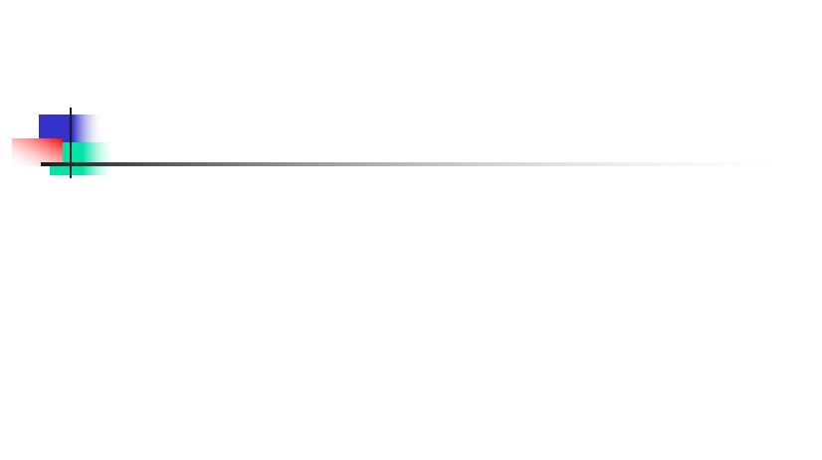
Thank You

